Slide 1
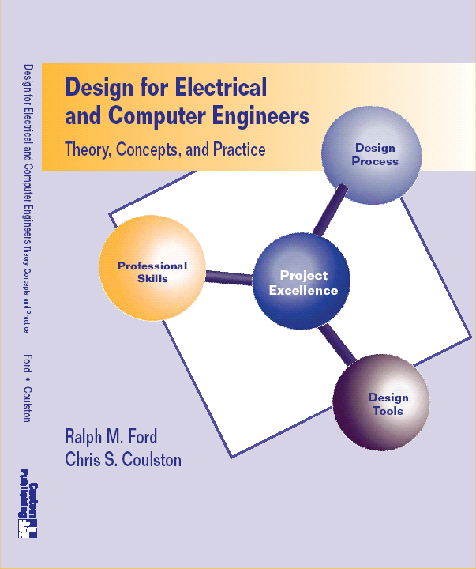
Chapter 2 – Project Selection & Needs Identification

Slide 2
Big Picture of Chapter

Slide 3
Big Picture of Chapter

Slide 4
Chapter 2 – Learning Objectives
By the end of this chapter, you should:
Have an understanding of the types of projects electrical and computer engineers undertake.
Understand and be able to apply sound criteria for project selection.
Know how to determine, document, and rank end-user needs.
Be familiar with some of the resources available for conducting research on design projects.
Have selected a project concept and developed a Problem Statement.

Slide 5
A Problem Statement
“Design a mechanical arm to pick apples from a tree.”
Is this a good problem statement?
What is a better one?

Slide 6
A Problem Statement, cont’d

Slide 7
Another Problem Statement
The traffic at the front of campus is too congested. I would like you to design a new traffic lane for the northbound traffic exiting at the intersection at the front of the college.
Is this a good problem statement?
What is a better one?

Slide 8
Another Problem Statement, cont’d

Slide 9
The “Design Space”

Slide 10
Project Selection

Slide 11
Types of Design Projects
Creative Design
Variant Design
Routine Design

Slide 12
Engineering Projects
Systems Engineering & Integration
  Large-scale, many people
Testing.
  Does system meet requirements?
Experimental Design
  Design experiment or apparatus
Analysis
  Correct problem, i.e. FMEA

Slide 13
Engineering Research Projects
Discovery or create something new.
Technology evaluation.
Applied Research.
  Translate fundamental results into something new
Fundamental Research
  Discovery of new scientific principles – without regard to near-term application.

Slide 14
Project Selection - Questions to ask (Heilmeier). Electrical Engineer and CEO of Bellcore.
What are your trying to do? Articulate your goals using absolutely no jargon.
How is it done today, and what are the limitations of current practice?
What is new in your approach, and why do you think it will be successful?
Who cares? If you are successful, what difference will it make?
What are the risks and payoffs?
How much will it cost? How long will it take?
What are the midterm and final ``exams'' to check for success?

Slide 15
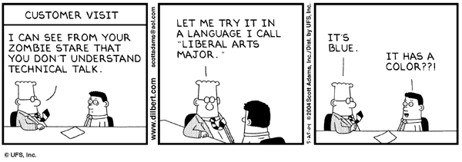
2.3 Needs Identification
Determine the “true” needs of the user

Slide 16
2.3 Needs Identification

Slide 17
Four Step Needs ID Process

Slide 18
Four Step Needs ID Process

Slide 19
Step 1: Gather Raw Data
What methods would you employ to do this?

Slide 20
Step 1: Gather Raw Data
Some methods are:
Interviews (see questions in the book).
Focus Groups
Observation – i.e IDEO shopping cart & heart device
See questions in book
Technology push-pull
Trends

Slide 21
Step 2: Translate Needs to Marketing Requirement
Marketing Requirements
Statement of Customer Needs in language of customer.
What the product should do, NOT how it should be achieved.
Short, action-oriented phrases
Example - “The system should have high quality audio.”

Slide 22
Example: Marketing Requirements
Example
In IDEO Video, the guy said, “these carts have been clocked going 35 mph”, what is the marketing requirement that goes with this statement?
Answer(s):
Cart should not move in wind.
Cart should not exceed XX mph.

Slide 23
Example: Marketing Requirements
Example
Customer says: “The current system is bulky and hard to hold”. The marketing requirement for this is?
Answer - “The system should be easy to hold with hand”
Example
Customer says “The system should be safe.”
Answer – “The system should be safe.”

Slide 24
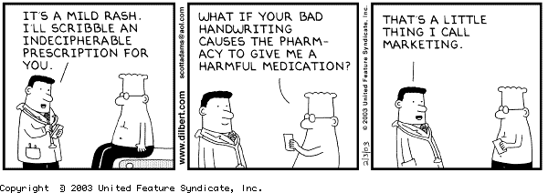

Slide 25
Step 3: Organize the Needs into a Hierarchy
Organize needs by functional similarity, not by importance!
What is functional similarity?

Slide 26
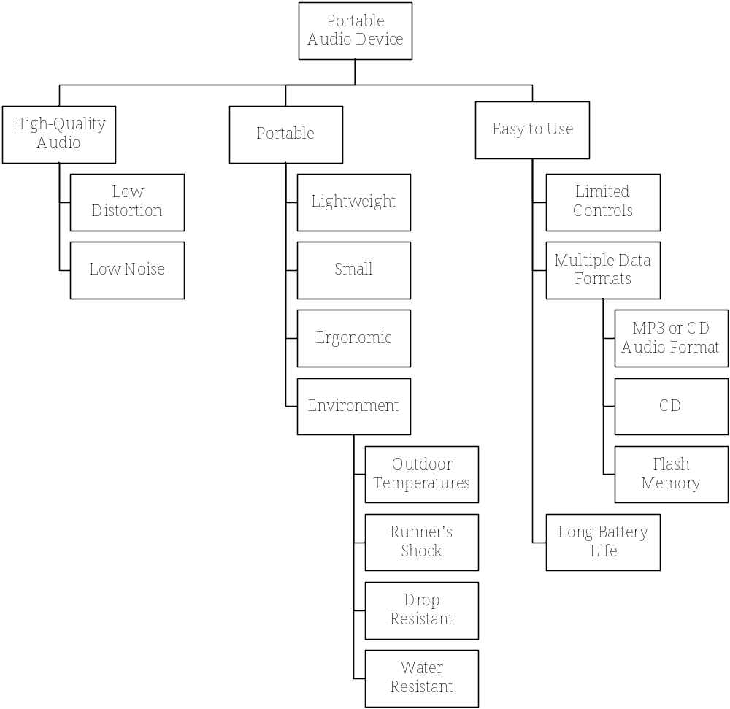
Tool: Objective Tree

Slide 27
Step 4: Rank the Needs
Rank the needs to determine the relative importance of each of the needs.
Systematically compare each need to all other needs.
Who should do this?

Slide 28
Tool: Pairwise Comparison Matrix
 | High-Quality Audio | Portable | Easy-to-Use | Score
High-Quality Audio
Portable
Easy-to-Use

Slide 29
Step 5: Review the Outcomes
This is just a process that embodies a good practice.
It is ultimately for making decisions about what is important to the end-user.
In the end ask yourself – “Does this make sense?” If not, you should make it so that it does or determine why not.

Slide 30
Let Review: Needs ID Process
Gather Raw Data (Customers, end-users)
Translate into Marketing Requirements.
Organize need into Hierarchy (Functional Similarity)
Rank Needs (Pairwise comparison – at each level)
Review the outcomes
YES – you will apply this to your design project!

Slide 31
In-Class Example – Needs Identification for the Electric Toothbrush

Slide 32
Research Strategy & Resources

Slide 33
Research Strategy
You need to become the experts on the problem and state-of-the-art in this area.
If you don’t, then you re-invent the wheel
If you don’t, then you look stupid.

Slide 34
Objectives of the Research Survey
What is the basic theory behind the concept?
How is it currently being done?
What are the limitations of the current designs or technology?
What are the similarities/differences between your concept and current systems?
Are there existing or patented systems that are relevant to the design?

Slide 35
Research Resources
See the book
Internet Resources

Slide 36
Computer & Electrical Eng Resources
The Chip Center, www.ChipCenter.com.
Circuit Cellar, www.CircuitCellar.com.
Component manufacturers.
Dr. Dobbs, www.ddj.com.
ON Semiconductor, www.OnSemi.com

Slide 37
Government Resources
US Government Official WebPortal, www.FirstGov.gov.
US Patent Office, www.uspto.gov.
  Patents back to 1790.
  Full text to 1790.
US Bureau of Labor Statistics, http://stats.bls.gov.
  How much people spend and how.
  Job outlooks.

Slide 38
Journal and Conference Papers
Detailed technical developments
IEEE, www.ieee.org. IEEE XPlore Database.
ACM, www.acm.org.
Compendex, www.engineeringvillage2.org.
  Indices to journal and conference papers in a broad scope of engineering fields, referencing material back to 1970.

Slide 39
The Problem Statement

Slide 40
The Problem Statement
A basic one consists of
Need Statement
  States the need being met.
  Does NOT state the solution.
Objective Statement
  What is being proposed to meet the Need.
  Preliminary description (avoid giving the solution – remember the apple picker)

Slide 41
Example: Problem Statement
The Item Finder [Klotz, Gupta, and Taddeo]
Need: People often misplace items such as keys, remote controls, books, watches, ID cards, wallets, and CD cases. As a result, time is spent looking for lost items.
Goal: Design an easy-to-use tracking system to locate everyday misplaced items. The system will consist of a transmitting base unit and small receivers to be attached to the items. The system will provide a method of identifying items and guiding the user to them.

Slide 42
Example: Problem Statement
Experimental Design: Gigabit Ethernet Card
Need: Our customer is investigating the performance of commercial grade gigabit Ethernet fiber optic equipment for computer data communications in a military environment. The proposed system will utilize an Intel Pro1000 XF server card. This is a harsh operating environment and its effects on the performance and lifetime of the equipment are unknown. The client wishes to understand how the military environment affects the optical power margin of the Intel Pro 1000 XF card and associated connectors and cabling.
Goal: The goal of this project is to design the experimental test procedures and equipment to determine the effects of temperature variations and vibration on the optical power margin and the lifespan of the system.

Slide 43
The Extended Problem Statement
Need.
Objective
Background
Marketing Requirements
Objective Tree
Ranking of the Needs.

Slide 44
Chapter 2 – Learning Objectives
By the end of this chapter, you should:
Have an understanding of the types of projects electrical and computer engineers undertake.
Understand and be able to apply sound criteria for project selection.
Know how to determine, document, and rank end-user needs.
Be familiar with some of the resources available for conducting research on design projects.
Have selected a project concept and developed a Problem Statement.

